Slide 1
Chapter 2
Data Structures: Classifying the Various Types of Data Sets
Elsevier/Academic Press
© Andrew F. Siegel, 2016

Slide 2
Data Structure Elements
Data Set:
  Measurements of items
    e.g., Yearly sales volume for your 23 salespeople
    e.g., Cost and number produced, daily, for the past month
Elementary Units:
  The items being measured
    e.g., Salespeople, Days, Companies, Catalogs, …
A Variable:
  The type of measurement being done
    e.g., Sales volume, Cost, Productivity, Number of defects, …
Elsevier/Academic Press
© Andrew F. Siegel, 2016

Slide 3
How Many Variables?
Univariate data set: One variable measured for each elementary unit
  e.g., Sales for the top 30 computer companies.
  Can do: Typical summary, diversity, special features
Bivariate data set: Two variables
  e.g., Sales and # Employees for top 30 computer firms
  Can also do: relationship, prediction
Multivariate data set: Three or more variables
  e.g., Sales, # Employees, Inventories, Profits, …
  Can also do: predict one from all other variables
Elsevier/Academic Press
© Andrew F. Siegel, 2016

Slide 4
Numbers or Categories?
Quantitative Variable: Meaningful numbers
  e.g., Sales, # Employees
  Can add, rank, count
Qualitative Variable: Categories
  Ordinal Variable: Categories with meaningful ordering
    e.g., Bond rating (AA, A, B, …), Diamonds (VSI, SI, …)
    Can rank, count
  Nominal Variable: categories without meaningful ordering
    e.g., State, Type of business, Field of study
    Can count
Elsevier/Academic Press
© Andrew F. Siegel, 2016

Slide 5
Time-Series or Cross-Sectional?
Time-Series Data: Data values recorded in meaningful sequence
  Elementary units might be days or quarters or years
  e.g., Daily Dow-Jones stock market average close for the past 90 days
  e.g., Your firm’s quarterly sales over the past 5 years
Cross-Sectional Data: No meaningful sequence
  e.g., Sales of 30 companies
  e.g., Productivity of each sales division
  Easier than time series!
Elsevier/Academic Press
© Andrew F. Siegel, 2016

Slide 6
Example
Firm Sales Industry Group S&P Rating
IBM 66,346 Office Equipment A
Exxon 59,023 Fuel A-
GE 40,482 Conglomerates A+
AT&T 34,357 Telecommunications A-
Elsevier/Academic Press
© Andrew F. Siegel, 2016

Slide 7
Example (continued)
Cross-Sectional
Multivariate Data (3 variables)
Firm Sales Industry Group S&P Rating
IBM 66,346 Office Equipment A
Exxon 59,023 Fuel A-
GE 40,482 Conglomerates A+
AT&T 34,357 Telecommunications A-
Elementary
units
Quantitative variable
Nominal Qualitative variable
Ordinal Qualitative variable
Elsevier/Academic Press
© Andrew F. Siegel, 2016

Slide 8
Example
Year Unemployment Rate
2005 4.9%
2006 4.4%
2007 5.0%
2008 7.3%
2009 9.9%
2010 9.3%
2011 8.5%
2012 7.9%
2013 6.7%
2014 5.6%
Elsevier/Academic Press
© Andrew F. Siegel, 2016

Slide 9
Example
Time series
Year Unemployment Rate
2005 4.9%
2006 4.4%
2007 5.0%
2008 7.3%
2009 9.9%
2010 9.3%
2011 8.5%
2012 7.9%
2013 6.7%
2014 5.6%
Elementary unit
defined by “year”
Quantitative data
Elsevier/Academic Press
© Andrew F. Siegel, 2016

Slide 10
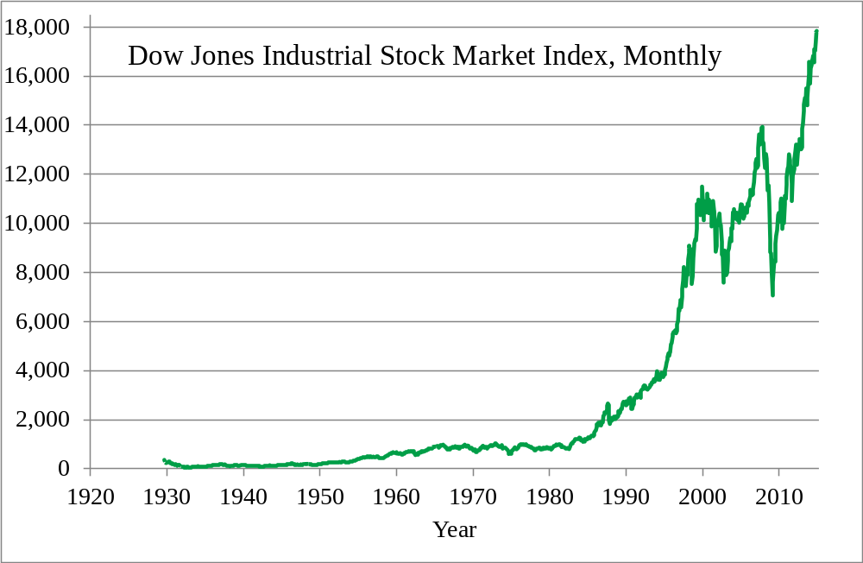
Stock Market – Time Series
Elsevier/Academic Press
© Andrew F. Siegel, 2016

Slide 11
Sources of Data
Primary Data
  When you control the design and data collection
    Production data from your factory
    Your firm’s marketing studies
Secondary Data
  When you use data previously collected by others for their own purposes
    Government data: economics and demographics
    Media reports – TV, newspapers, Internet
    Companies that specialize in gathering data
Elsevier/Academic Press
© Andrew F. Siegel, 2016

Slide 12
Observational Study and Experiment
Observational Data
  Measurements are observed as they occur naturally as part of a system
    Production data from your factory under ordinary circumstances
    Characteristics of your customers
Experiment
  Involves manipulation to control some characteristic(s) of the system so that we can assess causation.
    A/B Testing: Show one of two ads chosen at random, then observe the result
    Two random groups for testing medicine effectiveness:
    Treatment group and control group
Elsevier/Academic Press
© Andrew F. Siegel, 2016

